Slide 1
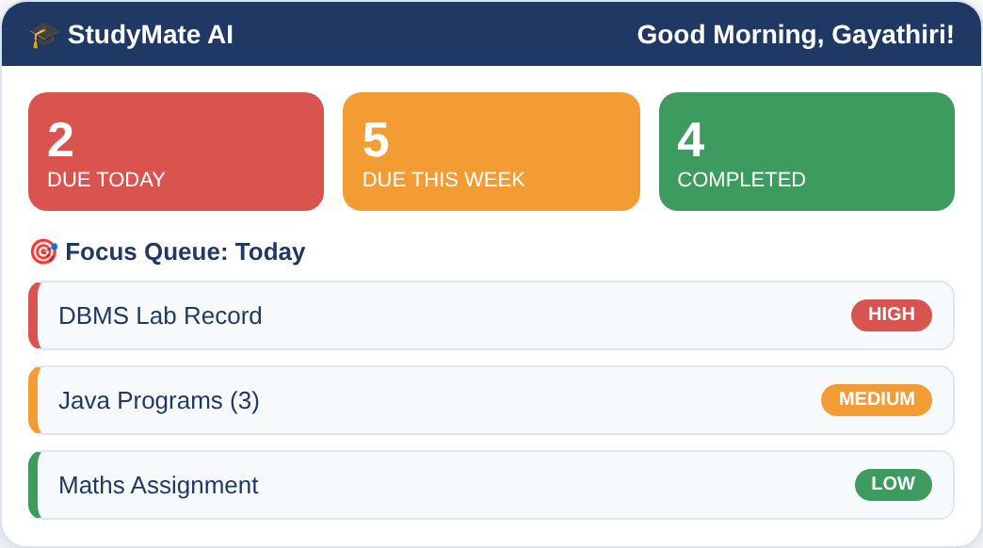
StudyMate AI
Autonomous Academic Task Agent
“Never Forget Your Academic Work Again”
Dashboard: focus queue and deadlines
Presented by: Gayathiri
B.Tech CSE | 3rd Year, Sec A

Slide 2
Problem Statement
1
Subject overload
6+
Juggling 6+ subjects, each with labs, records, homework and internals.
2
Lost announcements
subjects to track every semester
Notices get buried in WhatsApp groups and classroom feeds.
Last-minute records
Missed
3
Lab records are remembered only when faculty asks.
4
Passive to-do apps
deadlines from forgotten tasks
They do not reschedule work or calculate academic urgency.
StudyMate AI | Academic Task Agent
2

Slide 3
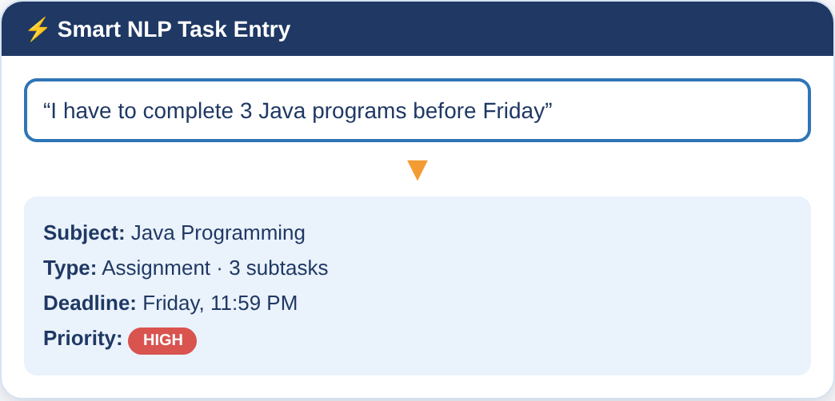
Proposed Solution
An AI agent that steps in before deadlines slip.
Smart natural-language entry
“3 Java programs before Friday” becomes tasks.
OCR vision
Blackboard photos and screenshots turn into tasks.
Forgetfulness protection
Alerts for repeatedly postponed work.
Natural-language parser extracts subject, deadline and priority
Auto-rescheduling
“Couldn’t finish today” rebalances the plan.
StudyMate AI | Academic Task Agent
3

Slide 4
Key Features
1
Smart Task Entry
2
Multi-Stage Reminders
3
Document & Photo OCR
Extracts subject, deadline and priority; splits multi-part programs.
Alerts 3 days before, 1 day before and on deadline morning.
Notices become verified tasks instantly.
4
AI Priority Matrix
5
Automatic Rescheduling
6
Forgetfulness Protection
Dynamic urgency score for every task.
Reorganises the study queue without overloading tomorrow.
Audits stale, zero-progress and high-difficulty tasks.
StudyMate AI | Academic Task Agent
4

Slide 5
System Workflow
1
2
3
4
5
Input
NLP Parser
Priority Engine
Scheduler
Output
Text, OCR photo or screenshot
Subject, date, priority, subtasks
Urgency scoring
Reminders & rescheduling
Dashboard, calendar, WhatsApp alert
The AI Assistant answers “What do I need to finish today?” and triggers auto-reschedule on request.
StudyMate AI | Academic Task Agent
5

Slide 6
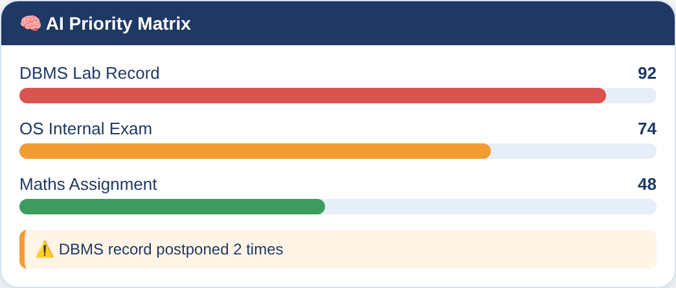
AI Priority Matrix & Forgetfulness Protection
Urgency score is derived from
Deadline
Difficulty
Time needed
Postponed
Continuous audit flags
Stale tasks and zero-progress deadlines
High-difficulty lab records near target date
Repeatedly postponed work
Priority scores and postponement warnings
StudyMate AI | Academic Task Agent
6

Slide 7
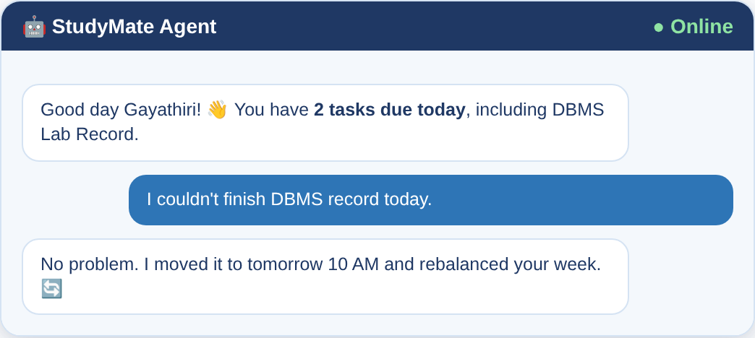
Application Modules
1
Dashboard
2
Add Task
Due today, this week, completed
NLP entry and OCR scanner
3
AI Assistant
4
Calendar
Chat copilot with quick actions
Monthly view with filters
AI Assistant with auto-reschedule
5
Subjects
6
Analytics
Labs, assignments, milestones
Completion rates, habit tips
Plus a notification centre with WhatsApp alert preview.
StudyMate AI | Academic Task Agent
7

Slide 8
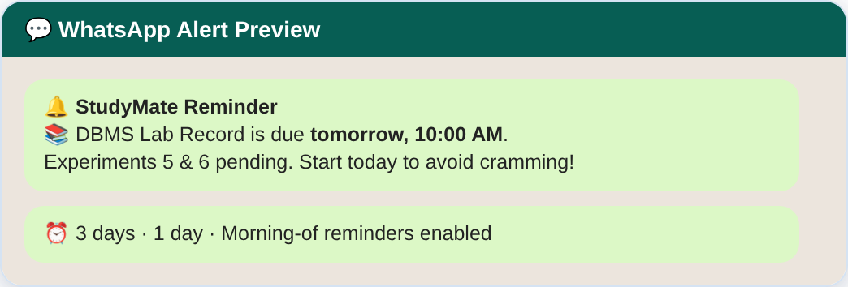
Conclusion & Future Scope
Conclusion
Future Scope
Moves beyond a to-do list to a proactive agent
Cuts missed deadlines and last-minute records
Reduces stress through staged reminders
Built specifically for college students
Live WhatsApp and SMS integration
Sync with college LMS and timetable
Mobile app with push notifications
StudyMate AI | Academic Task Agent
8

